Slide 1
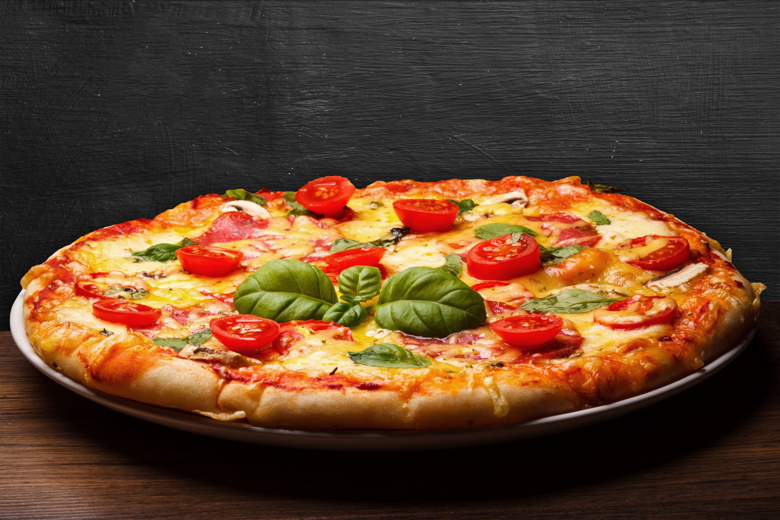



pizza Sales Project
by Mayank Chauhan

Slide 2


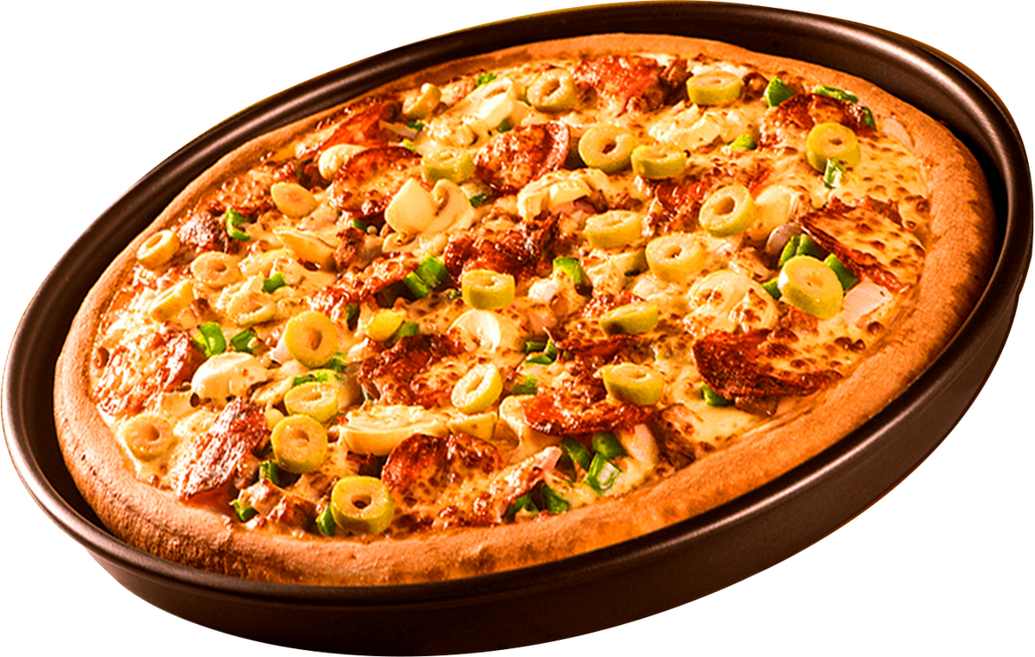

about the
project
This project focuses on analyzing pizza sales data using Power BI for interactive data visualization and SQL for data extraction and problem-solving. The primary goal is to gain actionable insights into the business performance through detailed analysis of sales metrics.
Together, Power BI and SQL enable a comprehensive sales analysis to support better decision-making and uncover growth opportunities in the pizza business.

Slide 3

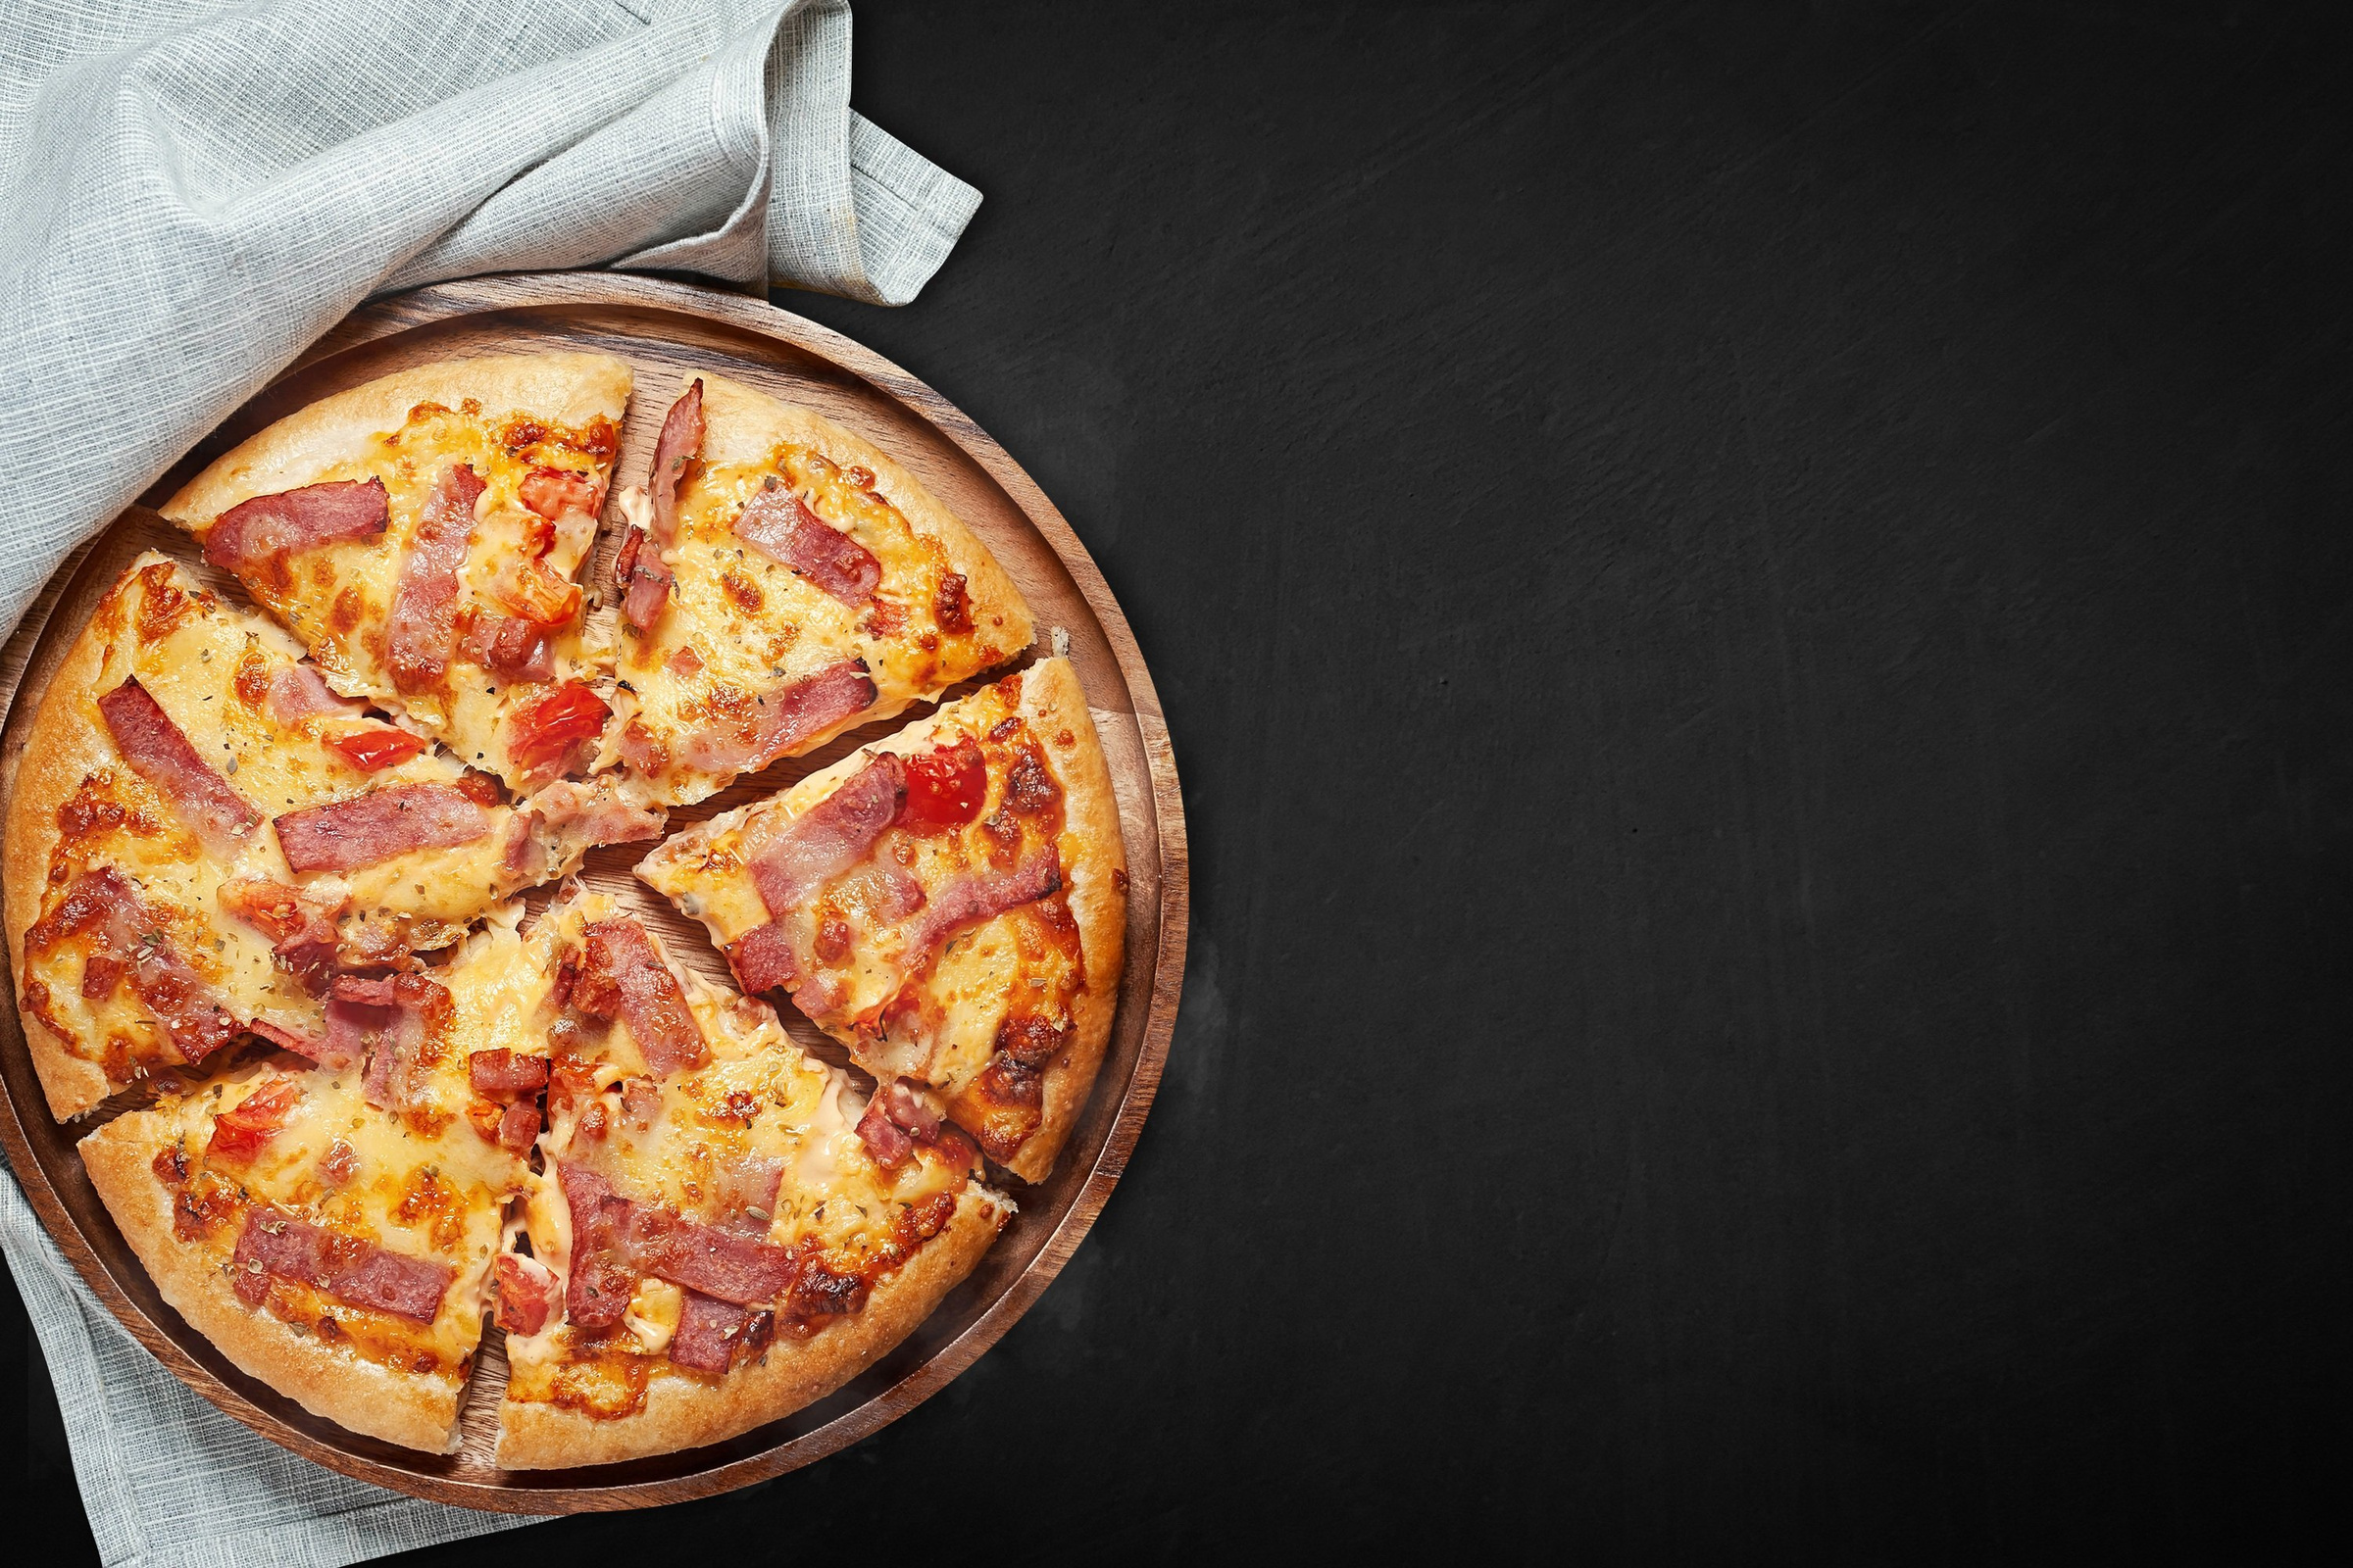
Objectives
This project is centered around the analysis of pizza sales using SQL for data exploration and Power BI for visualization. It aims to uncover insights into sales performance and customer preferences by combining data-driven queries with dynamic dashboards.
Key objectives include:
Retrieving the total number of orders placed.
Calculating the total revenue generated from pizza sales.
Identifying the highest-priced pizza on the menu.
Determining the most commonly ordered pizza size.
Listing the top 5 most ordered pizza types along with their quantities.
Using SQL, we answered these business questions with precise queries, while Power BI brought those insights to life through clear visualizations—such as total revenue, pizza size distribution, top-selling pizzas, and category-based performance. This integrated approach offers a holistic view of the business and helps in making informed decisions.

Slide 4
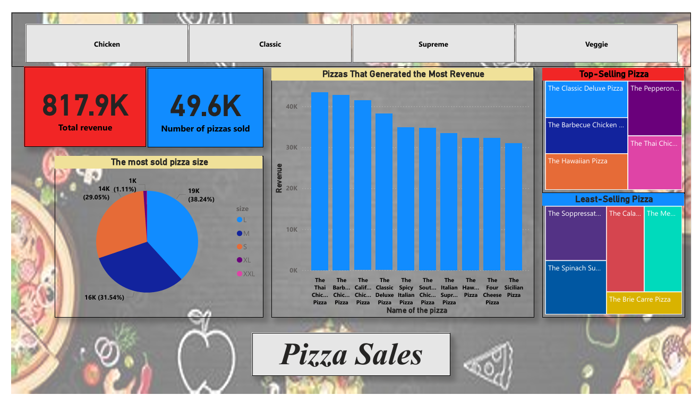
POWER BI DASHBOARD

Slide 5
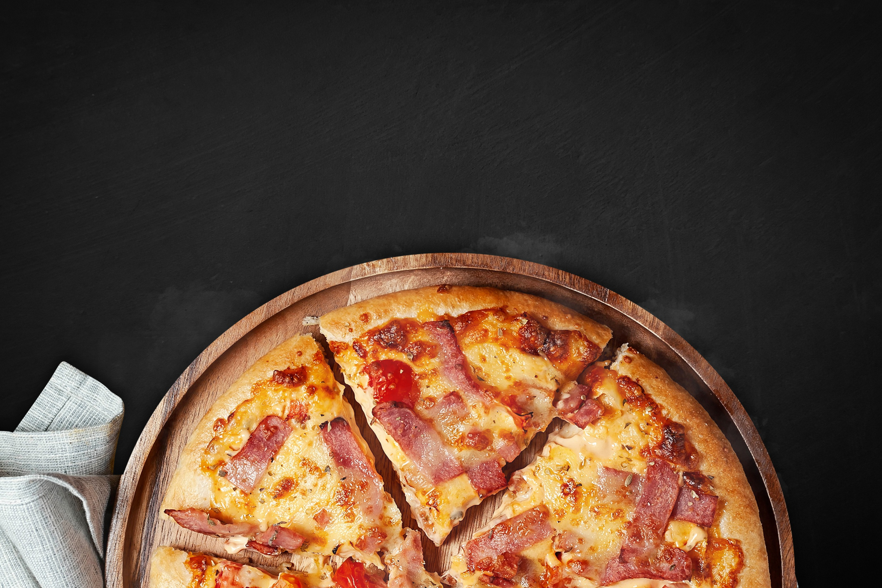
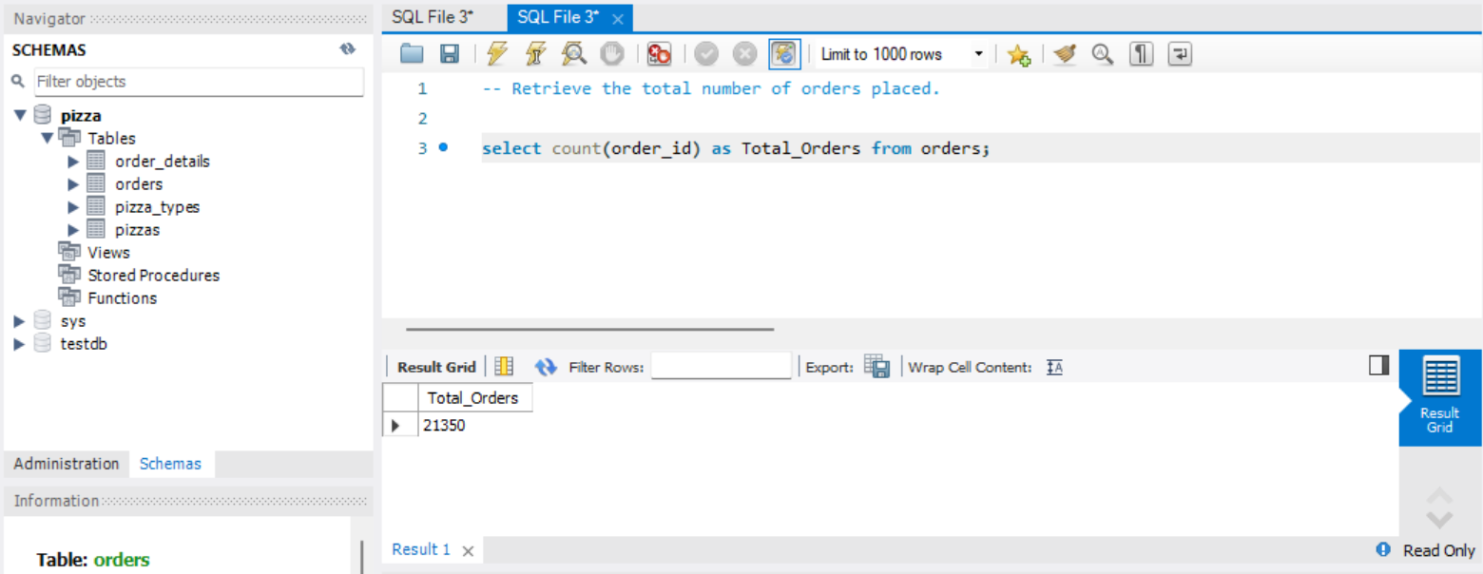
Retrieve the total number of orders placed.

Slide 6
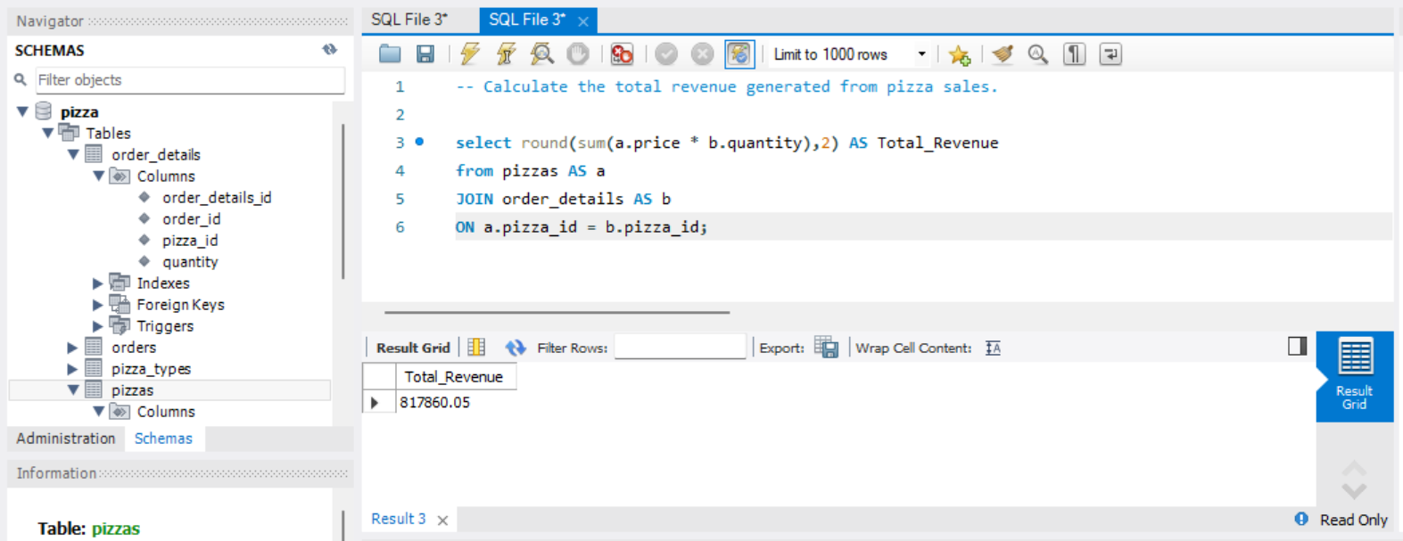
Calculate the total revenue generated from pizza sales.

Slide 7
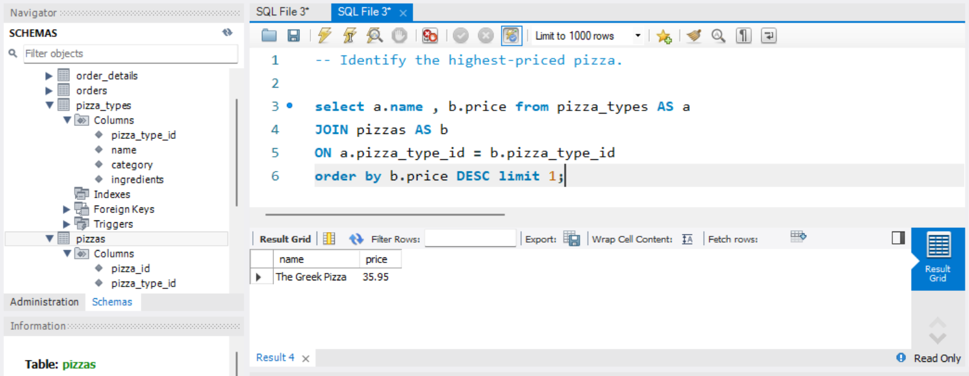
Identify the highest-priced pizza.

Slide 8
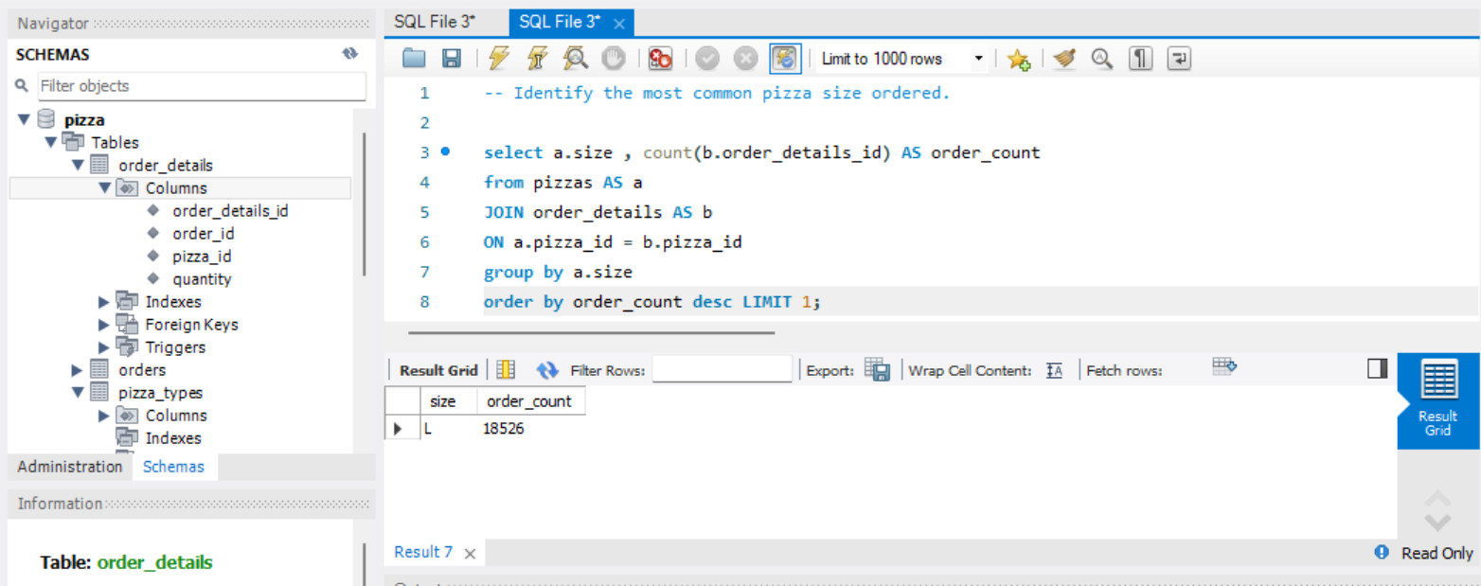
Identify the most common pizza size ordered.

Slide 9
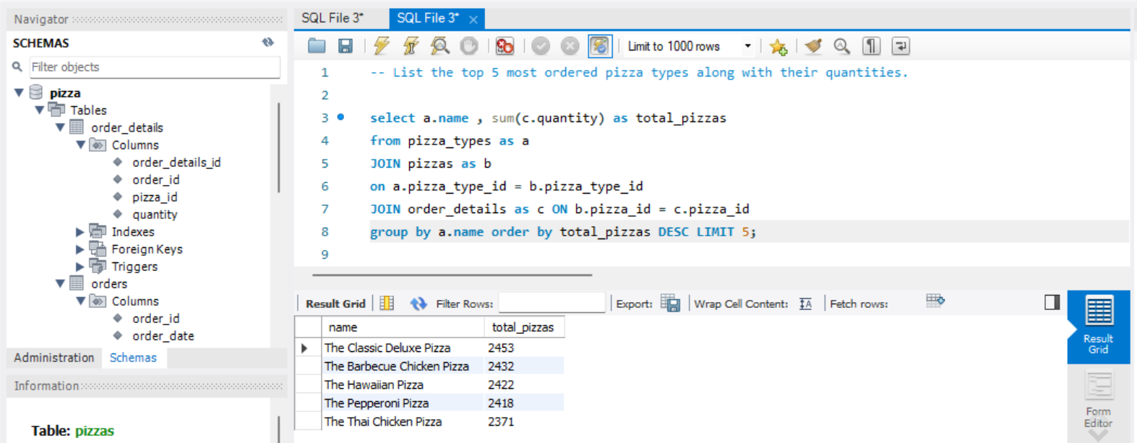
List the top 5 most ordered pizza types along with their quantities.

Slide 10
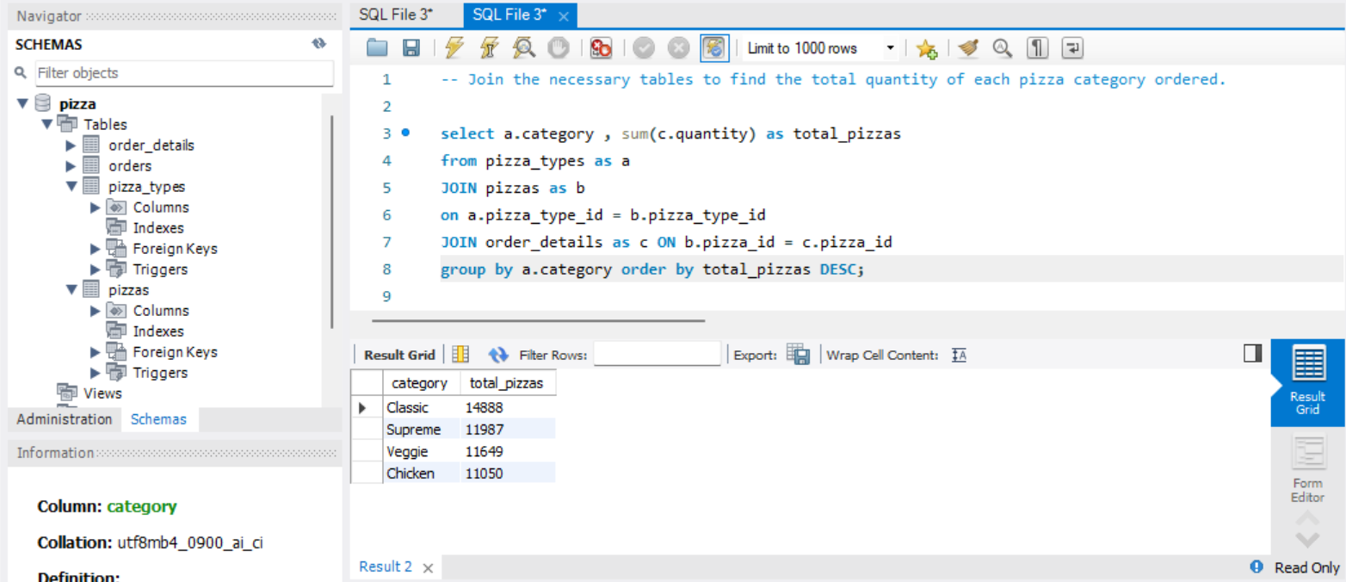
Join the necessary tables to find the total quantity of each pizza category ordered.

Slide 11
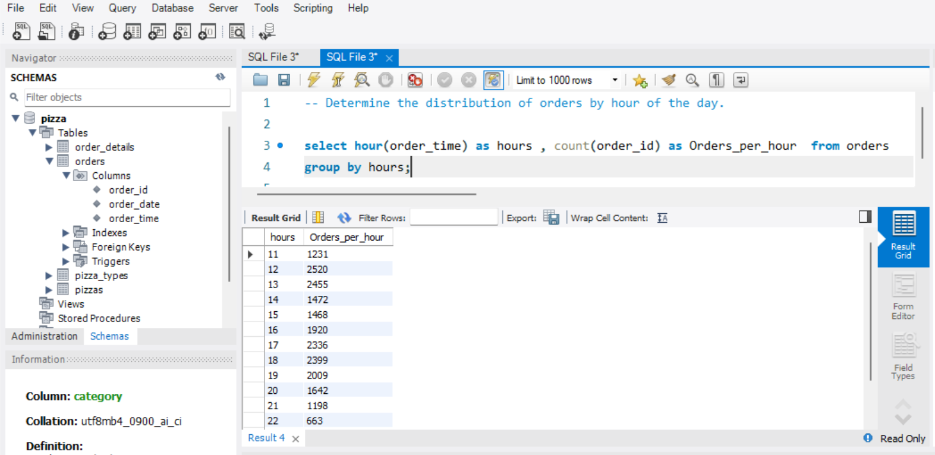
Determine the distribution of orders by hour of the day.

Slide 12
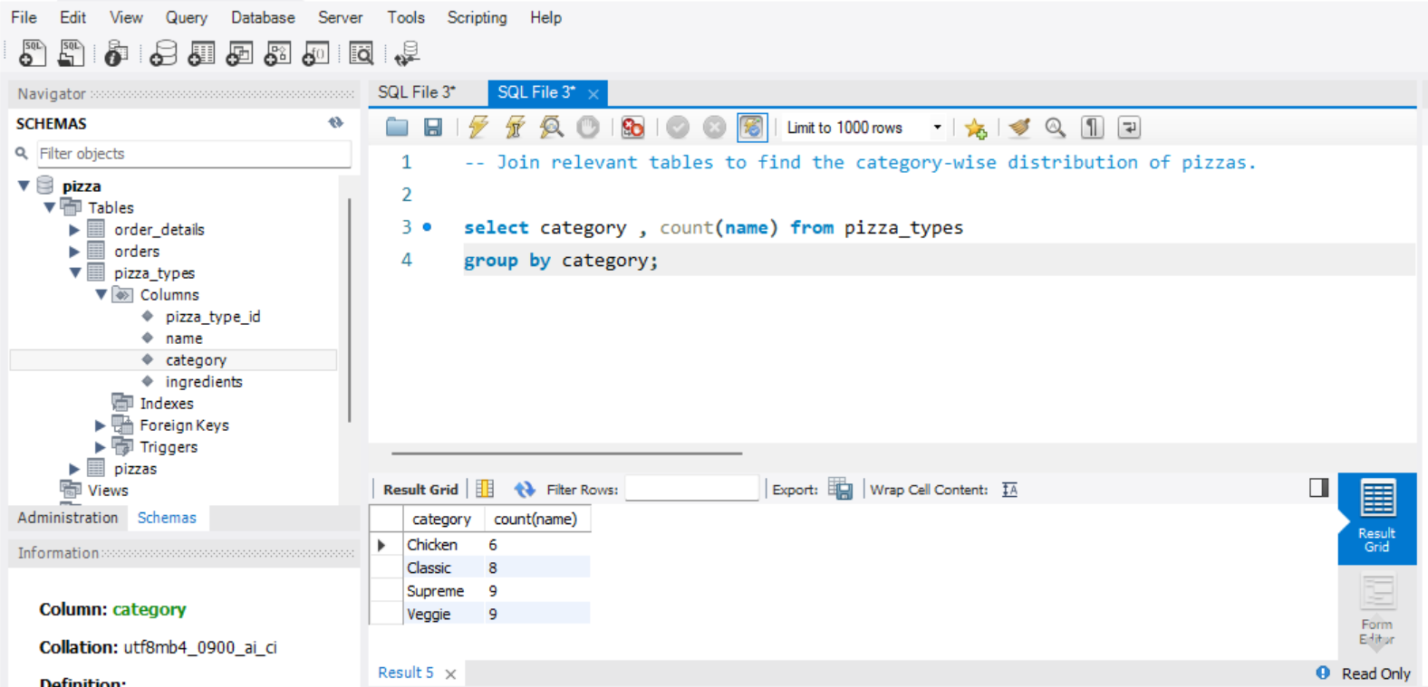
Join relevant tables to find the category-wise distribution of pizzas.

Slide 13
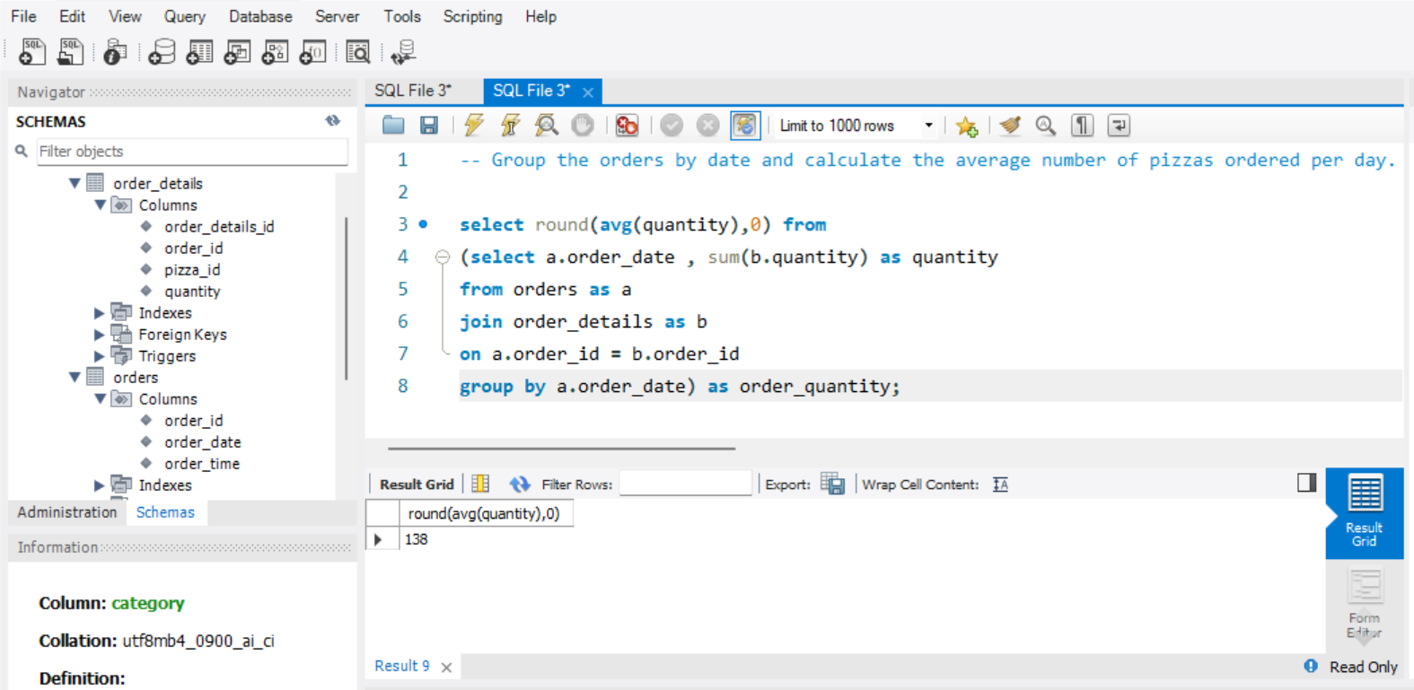
Group the orders by date and calculate the average number of pizzas ordered per day.

Slide 14
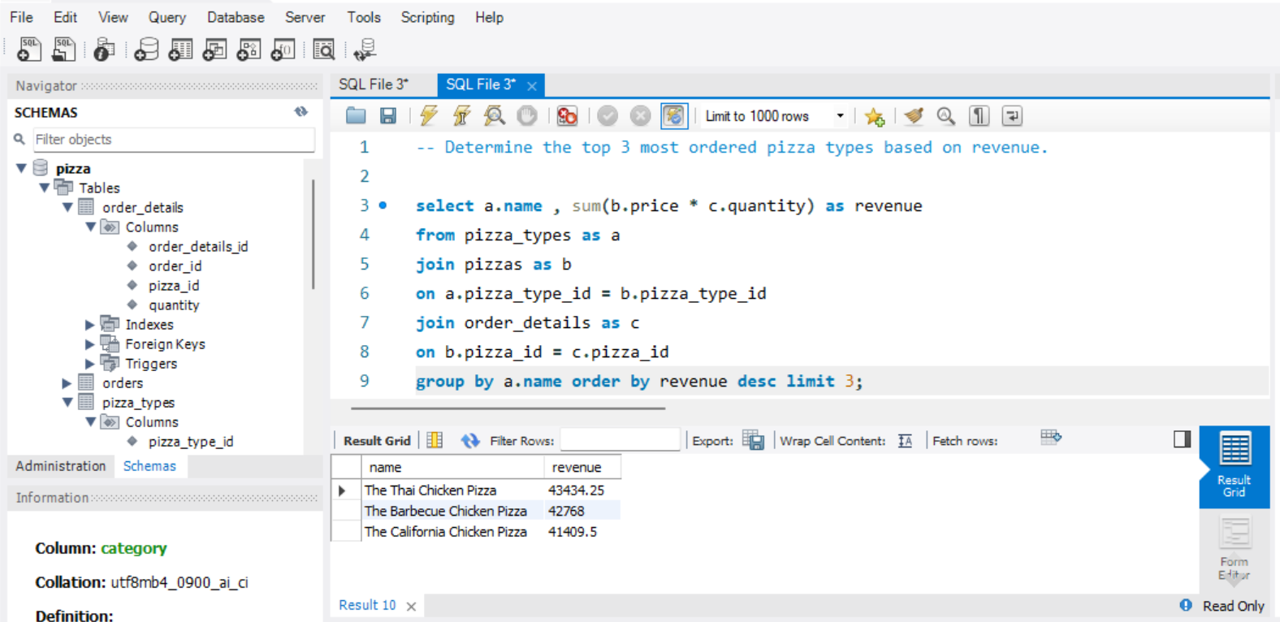
Determine the top 3 most ordered pizza types based on revenue.

Slide 15
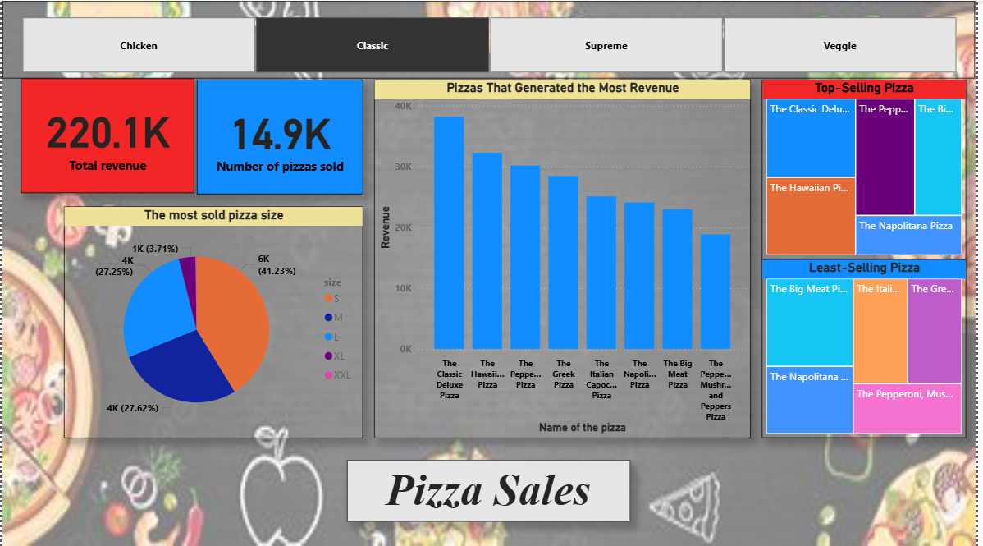
Insights of pizza sales based on ‘Classic’ category.

Slide 16
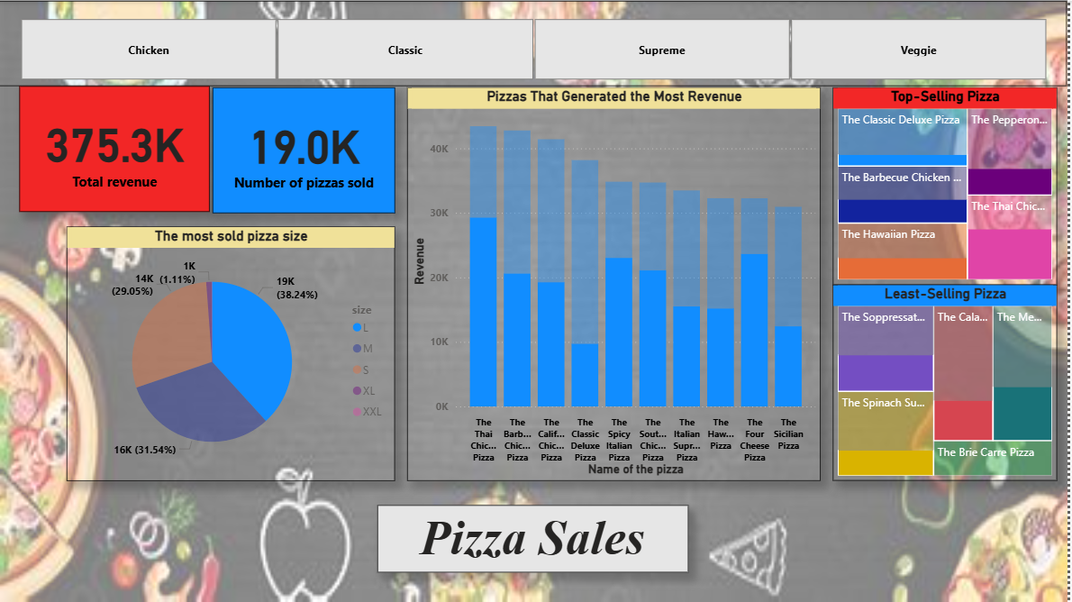
Insights of pizza sales based on ‘L’ PIZZA SIZE.

Slide 17
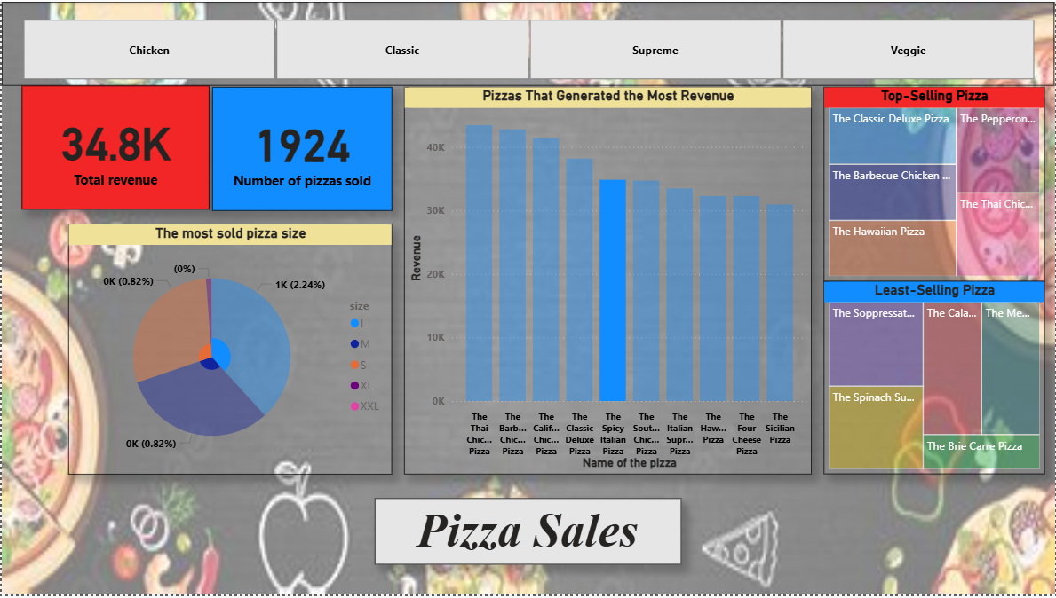
Insights of pizza sales based on ‘The spicy italian’ PIZZA.

Slide 18
thank you!

